Slide 1
Incentivizing Software Adoption within Organizations: A Framework Leveraging Mechanism Design, Network Effects, and Gamification Research In Progress
ABSTRACT
Adopting software is a critical process for organizations to drive digital transformation. Effective strategies must be in place to ensure success that encourages employee engagement and participation. However, employee willingness to embrace change has significantly declined over the last decade. Surprisingly, limited research has explored solutions to this costly and high-risk issue. This paper offers a comprehensive framework that integrates mechanism design, network effects, and gamification to incentivize software adoption in the workplace. By leveraging an application-based reward system, employees are encouraged to complete tasks, participate in competitions, answer quiz questions, and engage in events that connect to the desired software solutions. The framework aligns the reward system with organizational goals, using mechanism design to promote desired behaviors and maximize user engagement. Network effects foster a sense of community and positive peer influence. Preliminary empirical research utilizing surveys, interviews, and quantitative analysis indicates the positive impact of the integrated framework on user engagement and software adoption. These findings offer actionable insights for organizations aiming to strengthen software adoption initiatives and navigate digital transformation challenges successfully.

Slide 2




The Problem
Software adoption has significantly declined over the last decade significantly impacting digital transformation efforts
Digital Transformation Vision
The Challenge
People Are Needed to Meet Company Goals
Employee Productivity Is At An All Time Low
Lack of Incentive For Employees to Support Change
3. Poor Change Management – Function Focused
Company Goals
People
Missing An Effective Mechanism
To Create Alignment
Technology
Digital Transformation - Technology Facilitates Company Goal Achievement

Slide 3
The Gap In Research
Opportunity
Employ Mechanism Design Principles in Conjunction with Human-Centered Gamification Strategies and Network Effects to Drive Technology Adoption To Attain Company Goals
Gaps In Research
Alignment of Software Strategies and Company Objectives: There needs to be more research on how companies can successfully align software strategies to meet company objectives through mechanism design, gamification, and network effects to engage user adoption.
Software User Experience Design Focus: There has been much research around how integrating human factors along with user experience design is critical in the software development process, they don’t account for the large investments already made into existing software and how to increase adoption in those tools with a human-focused mechanism for adoption.
Sustainability and Scalability of Adoption Strategies: While some studies focus on initial implementation phases, there is a gap in research exploring the sustainability and scalability of software adoption strategies over time, especially in rapidly changing technological environments
Role of Leadership and Change Management: While there is recognition of the importance of leadership and change management in successful software adoption, there may be a gap in research exploring specific leadership strategies and change management practices that facilitate effective adoption through gamification and network effects.
Effective Gamification Frameworks: Much of the existing research focuses on attributes of gamification to engage human behaviors, but very little research utilizing a human-behavior framework to holistically identify the balance of right-left brain attributes along with positive and negative features and how they drive a successful balance of human behavior.
User Empowerment and Ownership: Within enterprise information systems, more research is needed on how companies can empower users to engage and provide feedback and insights on improving tool utilization or using ownership to incentivize employee use.

Slide 4


Solution Mechanism System Utilizing Octalysis Framework
Negative
^{Motivators (Black Hat)}
^{Positive}
^{Motivators (White Hat)}
Company Goals
People
- Epic Meaning (Int)*
- Empowerment (Int)*
- Accomplishment (Ext)*
Mechanism System
- Ownership (Ext)*
- Social Influence (Int)*
Technology Facilitates Goal Achievement
Mechanism System
- Scarcity (Ext)*
- Avoidance (Ext)*
- Unpredictability (Int)*
*Intrinsic (Int) & Extrinsic (Ext)

Slide 5
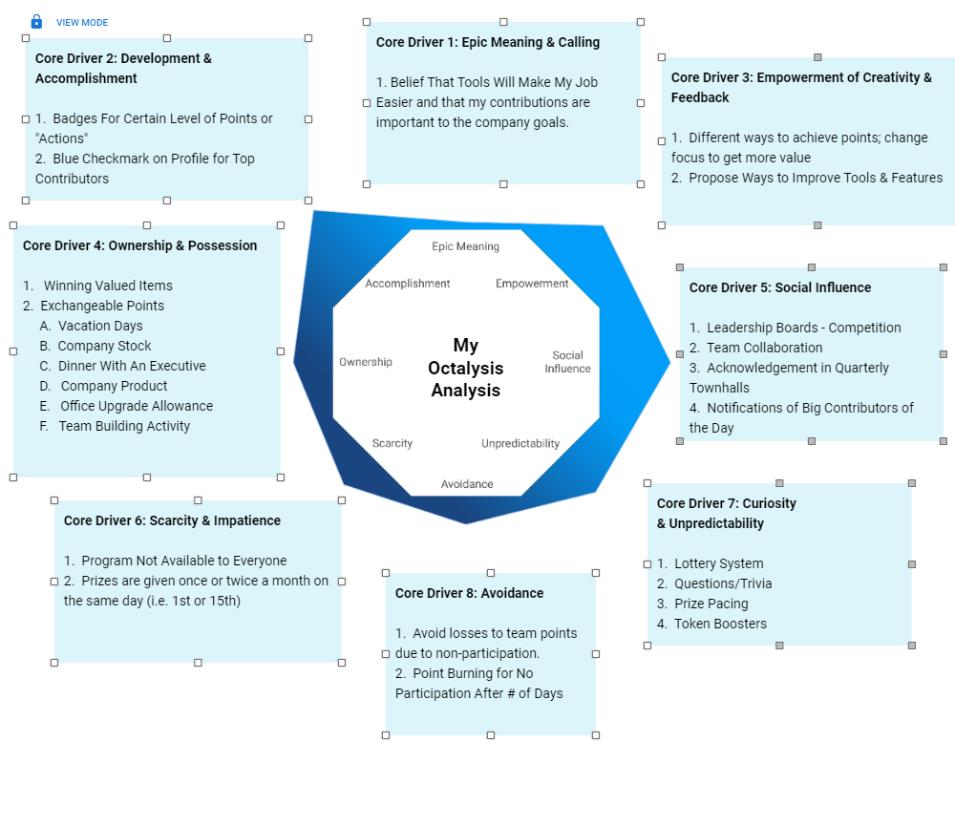
Octalysis Framework Breakdown
Framework to Engage Human-Focused Adoption of Technology

Slide 6
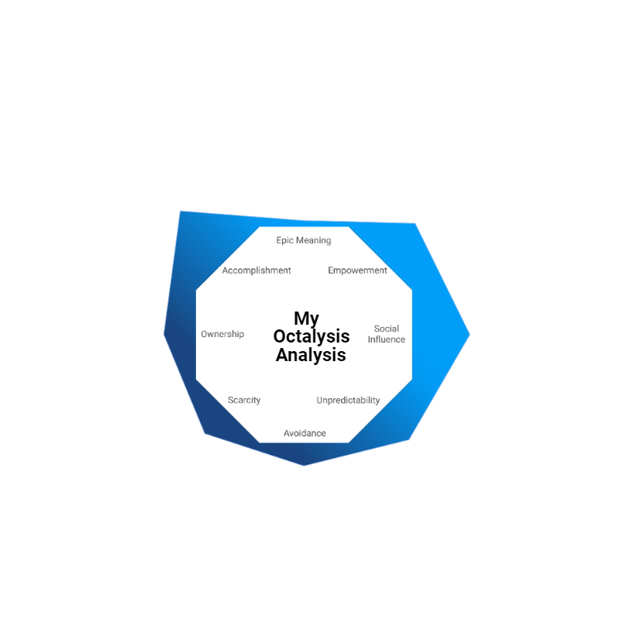







Mechanism Solution
Methodology - Octalysis Gamification Framework
Manage Through Single Interface on Smartphone App & Desktop App
People
Gamification
Mechanism System
System-Related Activities Defined In Mechanism System
User Notifications
- Actions
- Team Contribution
- Leaderboard/Rankings
- Opportunities
- Badges
- Prizes
- Progress
Engage Users Through One Interface
Company Goals
Incentivizing and Orchestrating Work Habits with Technology To Contribute to Company Objectives
Network Effects
- Activities that impact Company KPIs
- Activities that impact OKRs
- Considerations for:
- Interest
- Onboarding
- Standardization
- Scalability
Data From Information Systems
Technology

Slide 7
Research Methodology
Our ongoing empirical research aims to investigate the potential impact of the integrated framework on user engagement and software adoption within organizational contexts. Preliminary analysis of survey responses suggests promising trends towards increased user participation and interaction with the software following the implementation of the framework. Initial insights from interviews indicate a growing sense of motivation and satisfaction among participants attributed to the innovative gamification elements and user-centric design principles integrated into the framework. While quantitative analysis of adoption metrics is underway, early indications indicate potential improvements in software adoption rates.
These preliminary findings suggest the potential effectiveness of leveraging mechanism design, gamification, and network effects to align software strategies with organizational objectives and drive user engagement. Further analysis and validation will be conducted as our research progresses to establish conclusive evidence of the framework's impact on software adoption outcomes. Our ongoing study seeks to contribute valuable insights to the field of software adoption and inform strategic decision-making in organizations undergoing digital transformation.

